Slide 1
Upcoming Stakeholder Group meeting
Programme Office
RCC meeting
TITRE
18/10/2012

Slide 2
The 10th Stakeholder Group meeting will take place on 22 and 23 November 21012 in Copenhagen
Velkommen til Danmark!

Slide 3
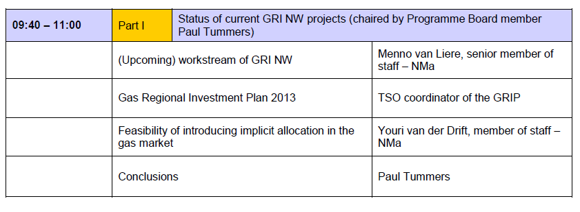
Part I of the agenda: focus on progress achieved (and next steps to be taken) in GRI NW projects

Slide 4
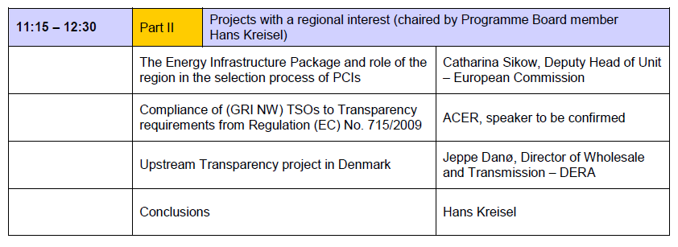
Part II of the agenda: focus on (European) projects that are of regional interest for stakeholders within GRI NW

Slide 5
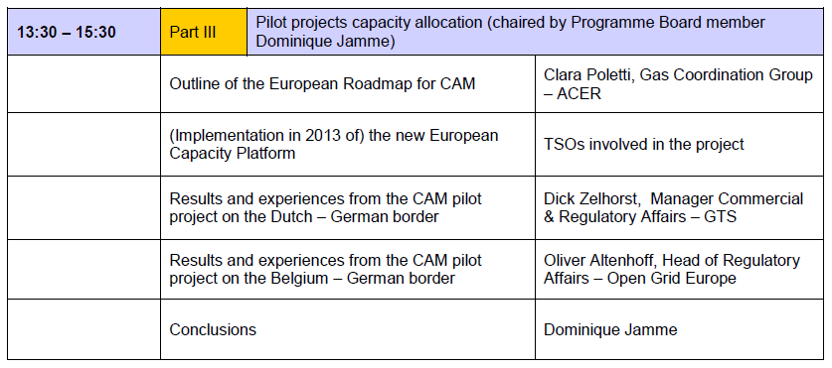
Part III of the agenda: focus is on pilot projects for CAM that take place within GRI NW region

